Slide 1
HUMANOID ROBOT
ROBOTIC HARDWARE SYSTEMS (MCTE 4362)
Presented by:
Muhammad Iqmal Danish bin Hasnan (1912461)

Slide 2
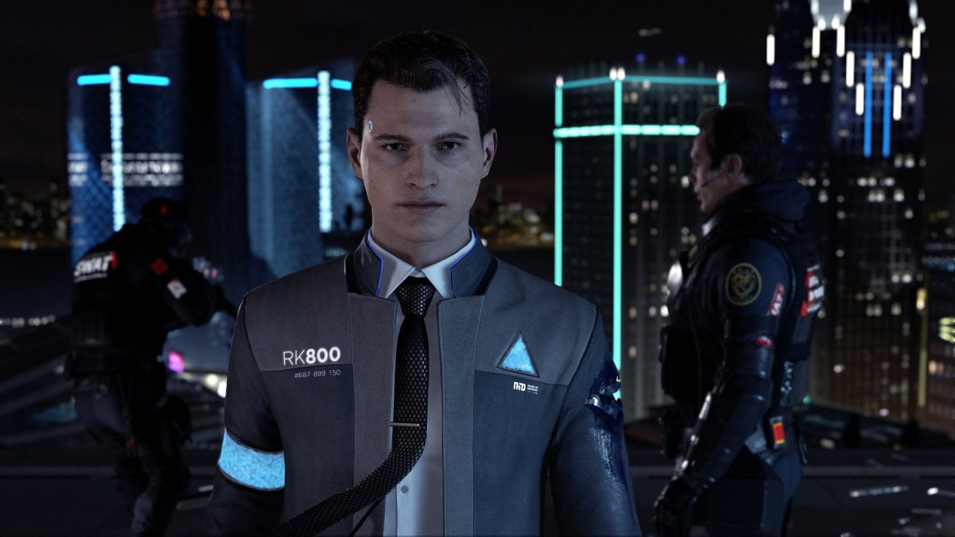
INTRODUCTION
Humanoid robots are machines designed to closely resemble the human form and imitate human behavior.
With their bipedal structure and human-like limbs, they aim to replicate the physical capabilities of humans.
These robots combine advanced technologies in robotics, artificial intelligence, and sensory systems to create a lifelike human-like experience.

Slide 3
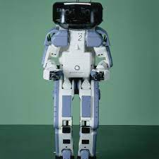
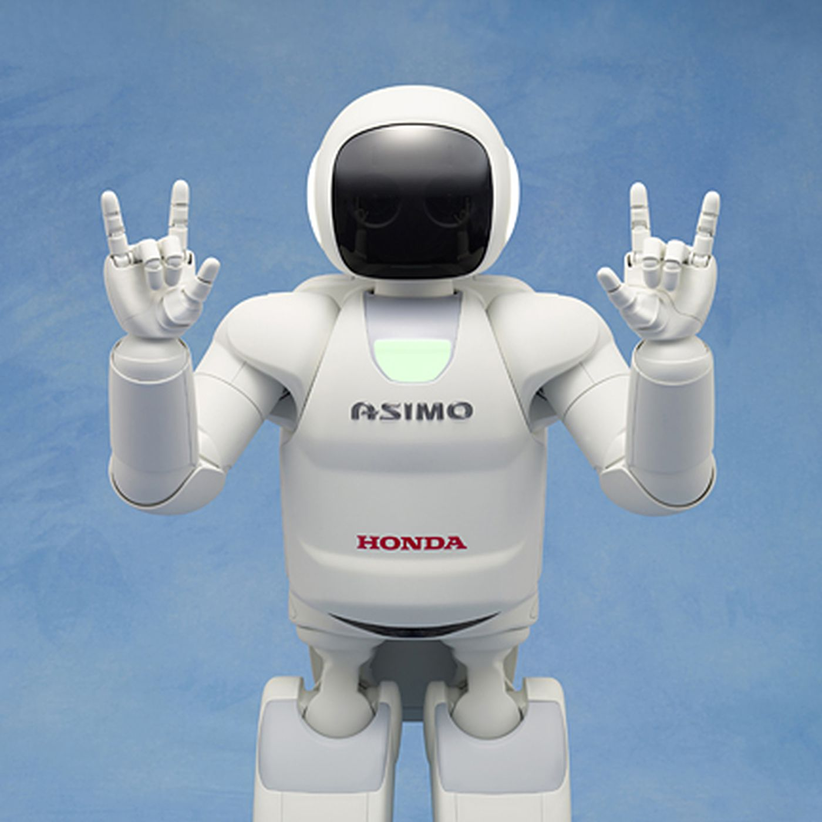
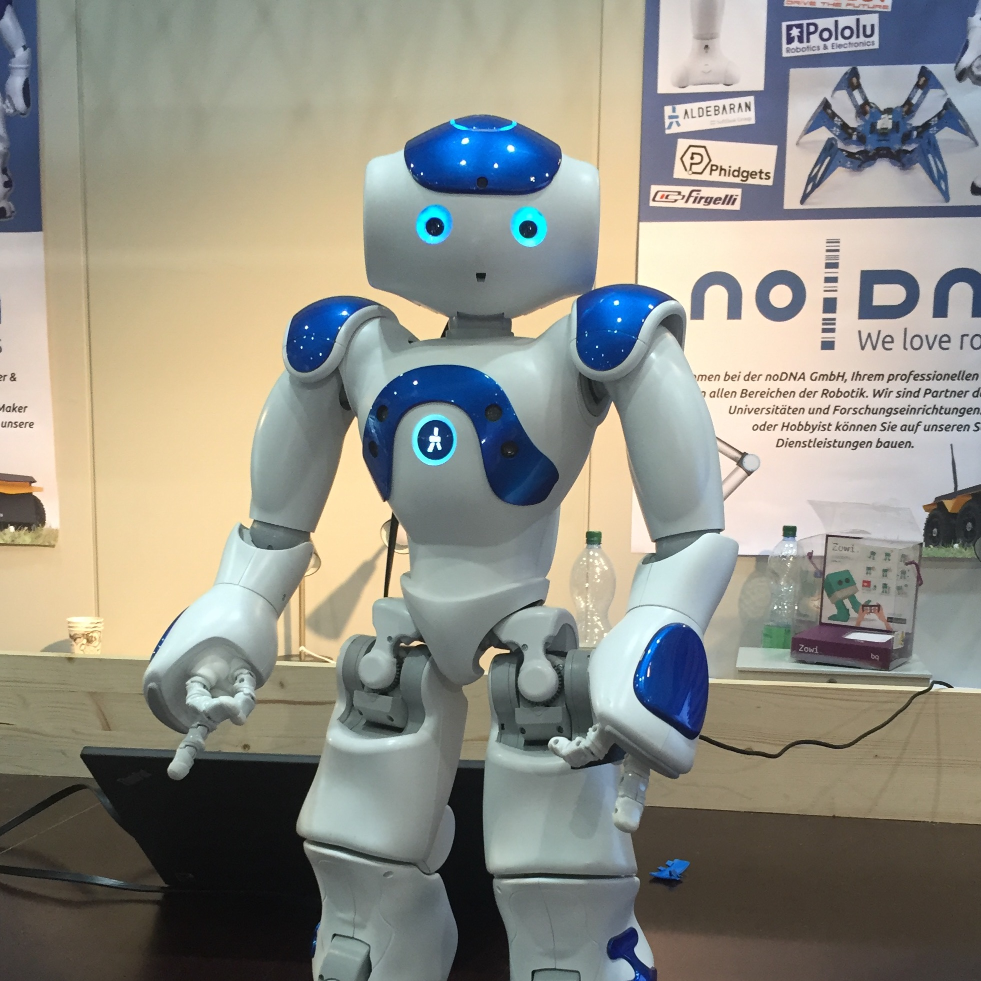
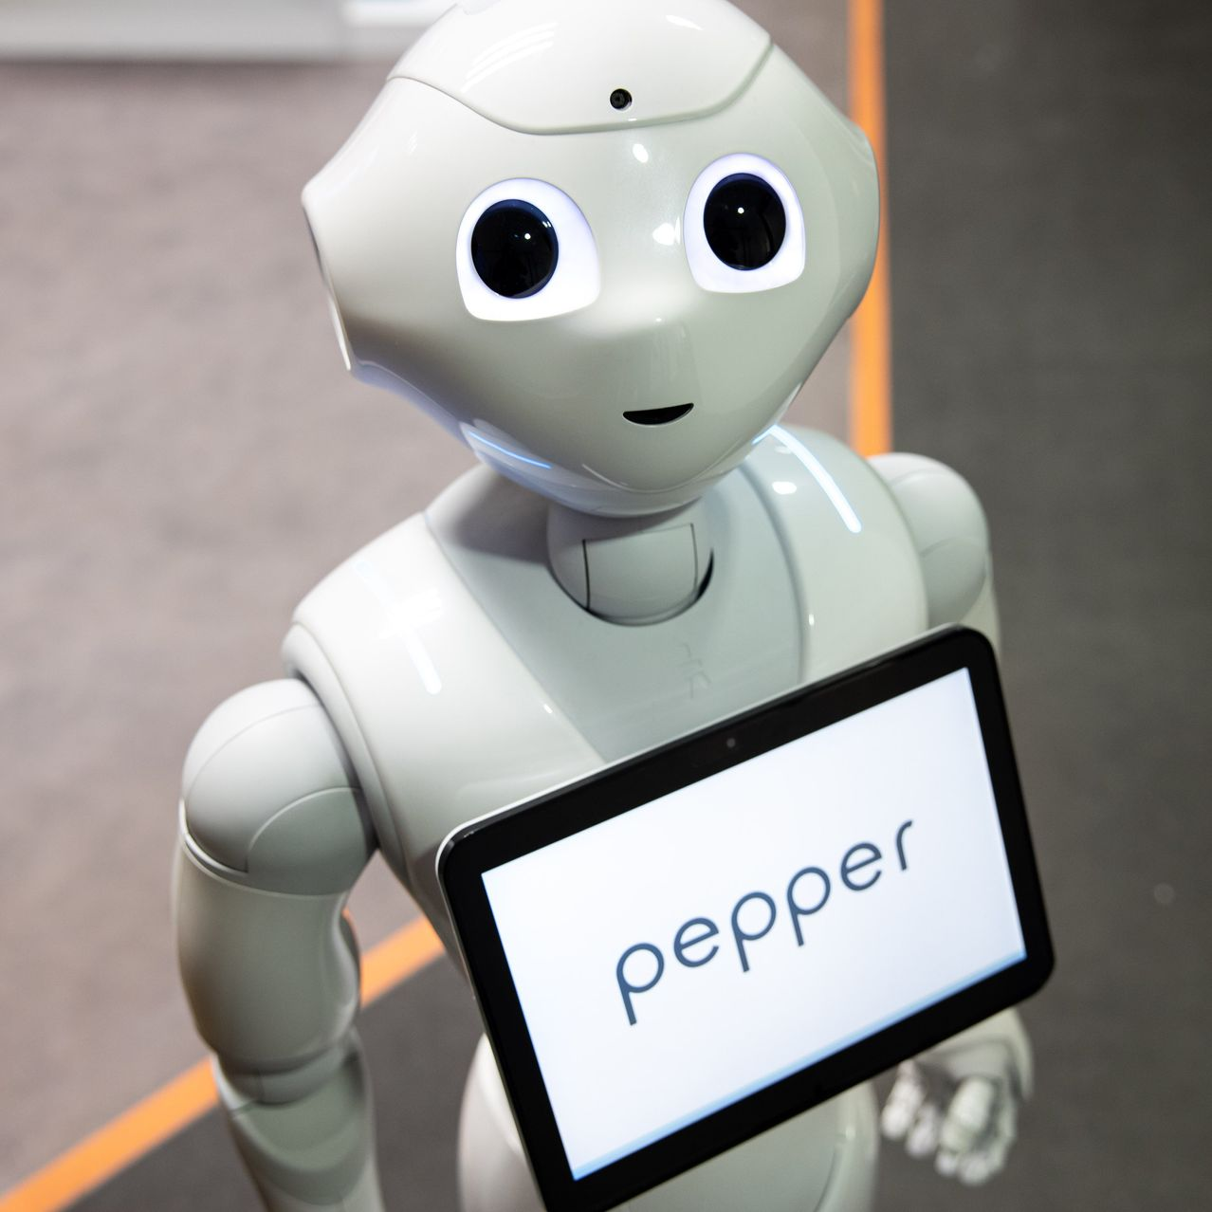
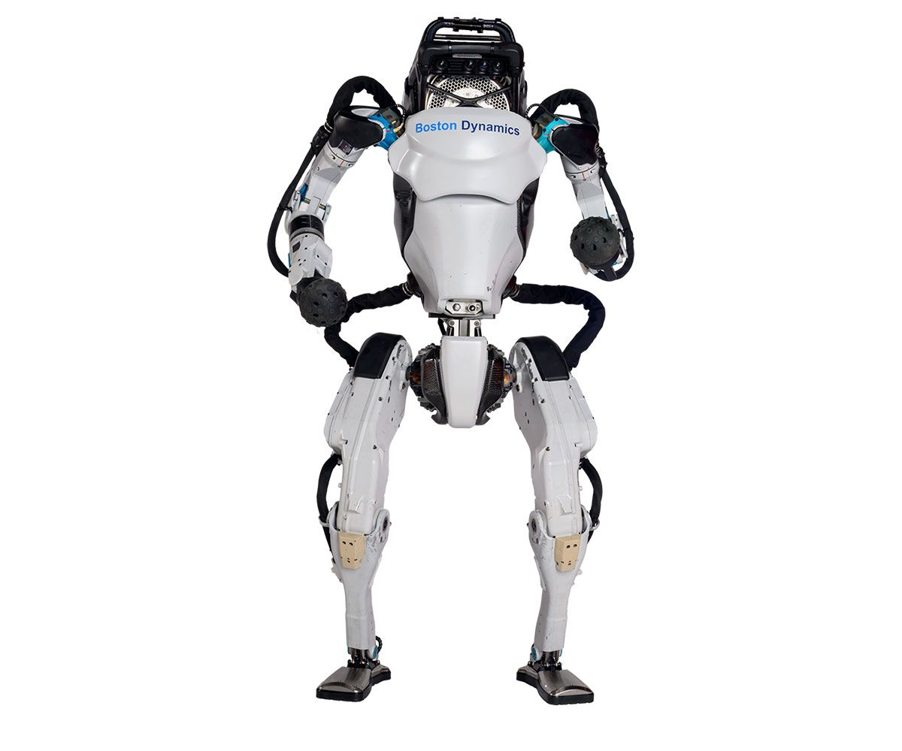
HISTORY
1973
2000
2006
2014
2013-2019
WABOT-1
ASIMO
NAO
Pepper
Atlas
Developed at Waseda University in Japan, WABOT-1 was the world's first full-scale anthropomorphic robot.
Developed by Honda, ASIMO (Advanced Step in Innovative Mobility) became one of the most recognizable humanoid robots.
Created by Aldebaran Robotics (now SoftBank Robotics), NAO is a small humanoid robot designed for research, education, and entertainment purposes.
Developed by SoftBank Robotics, Pepper is a humanoid robot designed for human interaction and companionship.
Developed by Boston Dynamics, Atlas is a highly advanced humanoid robot designed for versatile mobility and manipulation.

Slide 4
HISTORY
1973
2000
2006
2014
2013-2019
WABOT-1
ASIMO
NAO
Pepper
Atlas
Developed at Waseda University in Japan, WABOT-1 was the world's first full-scale anthropomorphic robot.
Developed by Honda, ASIMO (Advanced Step in Innovative Mobility) became one of the most recognizable humanoid robots.
Created by Aldebaran Robotics (now SoftBank Robotics), NAO is a small humanoid robot designed for research, education, and entertainment purposes.
Developed by SoftBank Robotics, Pepper is a humanoid robot designed for human interaction and companionship.
Developed by Boston Dynamics, Atlas is a highly advanced humanoid robot designed for versatile mobility and manipulation.

Slide 5
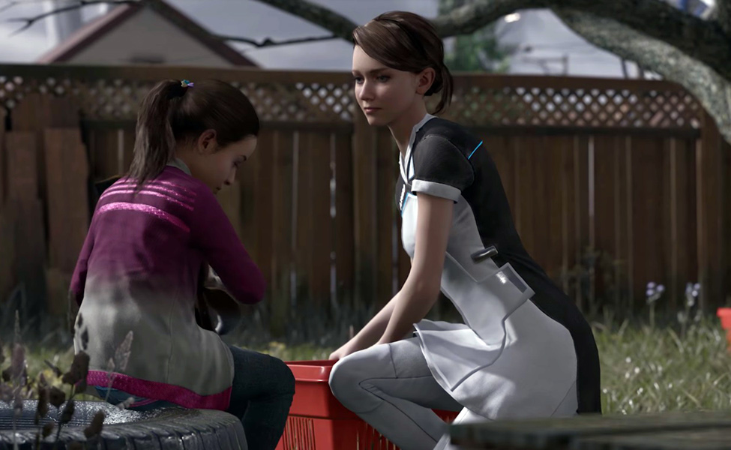
APPLICATION
Healthcare and Assistance
Providing companionship and emotional support to patients, especially the elderly or those with cognitive impairments.
Customer Service and Hospitality
Greeting and interacting with customers in hotels and shopping malls by providing information.
Education and Research
Assisting in educational settings by acting as teaching assistants.

Slide 6

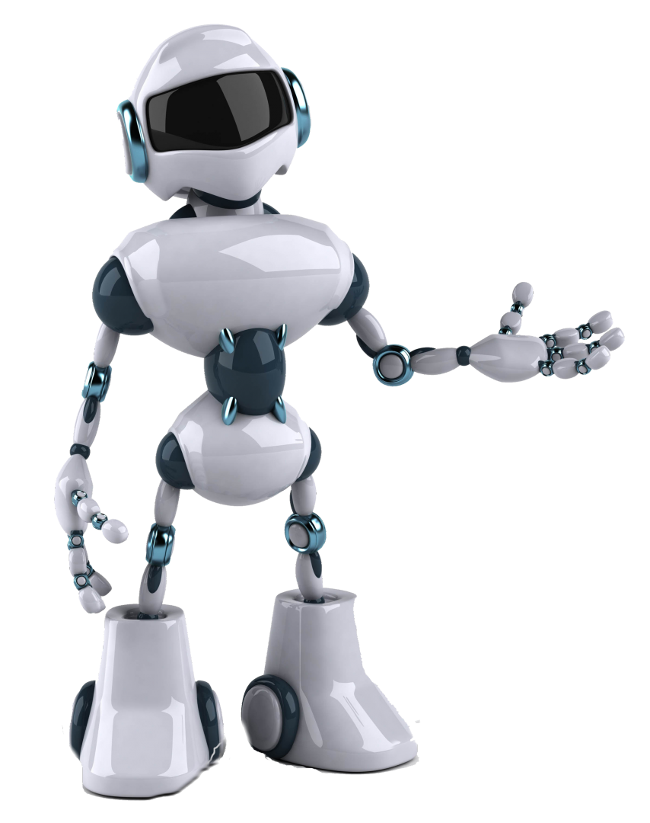
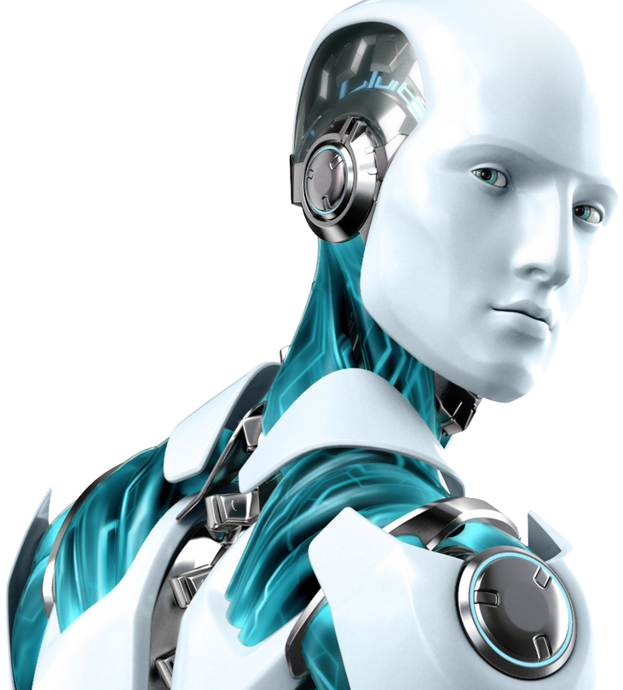
MAIN COMPONENTS OF THE ROBOT
1. Body Design
Humanoid robots are designed with a bipedal structure, allowing them to stand and walk on two legs, like humans.
Humanoid robots feature jointed limbs, including arms and legs, enabling them to perform a wide range of motions and tasks.
Humanoid robots are equipped with sensory systems, such as cameras and microphones, to perceive and interact with their environment.

Slide 7
MAIN COMPONENTS OF THE ROBOT
Locomotion Type | Explanation | Example Model
Bipedal Walking | Walking on two legs, imitating human gait | ASIMO by Honda
Quadrupedal Walking | Walking on all fours, like animals | Spot by Boston Dynamics
Wheeled Mobility | Moving on wheels or a wheeled base | Segway Loomo
Climbing | Ascending or descending vertical or inclined surfaces | ROBOTIS OP3
Crawling | Moving using hands and knees, like crawling | MORPH by NASA's Johnson Space Center
2. Locomotion
Humanoid robots achieve locomotion by moving their bodies in a coordinated manner to navigate their surroundings.
They utilize a combination of walking, balancing, and limb coordination to imitate human-like movements..

Slide 8
MAIN COMPONENTS OF THE ROBOT
Navigation | Description | Example Model
Sensor-based | Relies on sensors such as cameras, LIDAR, and ultrasonic sensors | Pepper by SoftBank Robotics
Vision-based | Utilizes visual data from cameras and computer vision algorithms | MIT Cheetah by Boston Dynamics
AI-based | Employs artificial intelligence algorithms for adaptive navigation | Sophia by Hanson Robotics
Global Positioning System (GPS) Navigation | Relies on satellite-based GPS signals for outdoor localization | Valkyrie by NASA
3. Navigation System & Control
Humanoid robots employ a variety of sensors to perceive their environment.
They utilize mapping techniques to create a representation of their environment.

Slide 9
MAIN COMPONENTS OF THE ROBOT
Data Collection | Description | Example Model
Camera | Captures visual data and images | Pepper by SoftBank Robotics
Depth Sensor | Measures the distance to objects and creates depth maps | PR2 by Willow Garage
Inertial Measurement Unit (IMU) | Measures acceleration, orientation, and angular velocity | NAO by SoftBank Robotics
Microphone | Records audio and captures sound | ASIMO by Honda
4. Data Collection
Data collection by humanoid robots involves the gathering of information from various sensors and sources to perceive and understand the environment.
Humanoid robots are equipped with a range of sensors.

Slide 10
MAIN COMPONENTS OF THE ROBOT
5. Data Transmission
Humanoid robots utilize transmission methods to exchange data and information between various components
Transmission enables the flow of sensory data, such as visual information or tactile feedback, from the robot's sensors to its control system.
Data Transmission | Description | Example Model
Wired Transmission | Data transfer through physical wired connections | NAO by SoftBank Robotics
Wi-Fi | Wireless local area networking for data transmission | Atlas by Boston Dynamics
Bluetooth | Short-range wireless communication for data transfer | ASIMO by Honda
Ethernet | Wired network communication for high-speed data transfer | iCub by Istituto Italiano di Tecnologia

Slide 11
MAIN COMPONENTS OF THE ROBOT
6. Power Management
Humanoid robots implement power management strategies to optimize the usage of electrical power.
They employ power conservation techniques to extend their operating time.
Power Management | Description | Example Model
Battery | Portable energy storage that provides mobile operation | Pepper by SoftBank Robotics
Fuel Cell | Generates electricity through a chemical reaction | ASIMO by Honda
Solar Power | Harnesses energy from sunlight to generate electricity | RoboCup Humanoid League Robots
Tethered Power | Continuous power supply through a physical tether | Atlas by Boston Dynamics

Slide 12
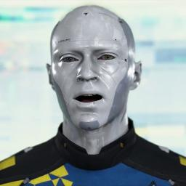
CONCLUSION
Humanoid robots represent a remarkable technological achievement in the field of robotics.
With their human-like form and capabilities, they have the potential to revolutionize various industries and domains.
Their capabilities and potential applications make them a fascinating and promising area of research and development, with the potential to reshape the way we live and interact with technology in the years to come.

Slide 13
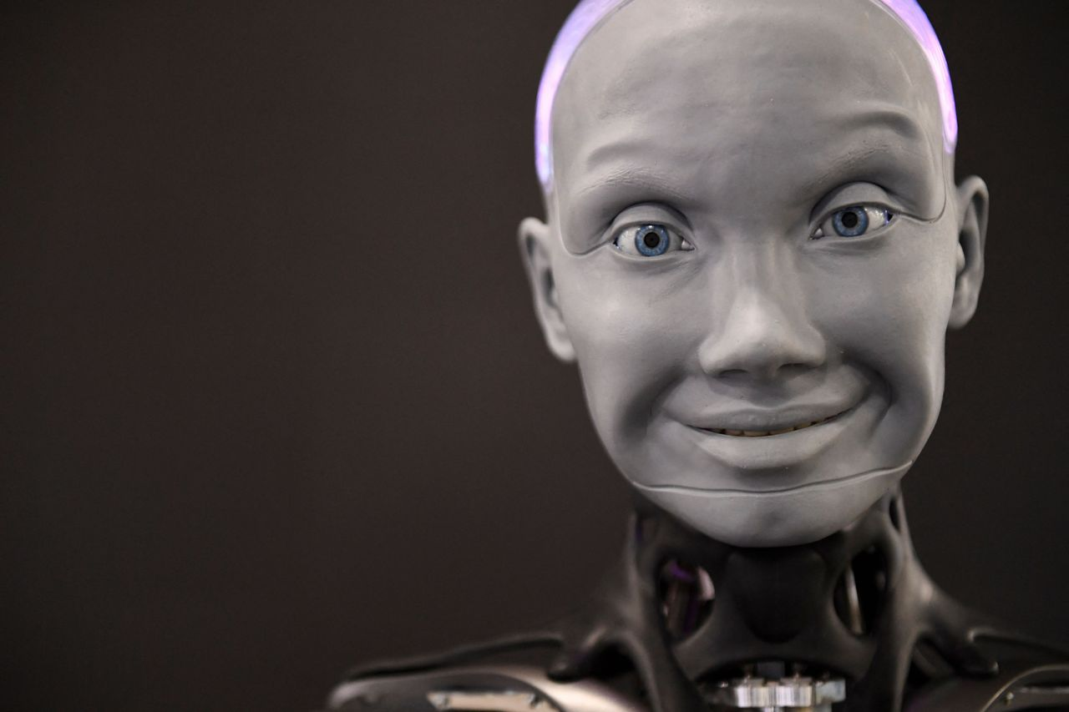
THANK YOU!

